Slide 1
Continuation Blind Test Healthy vs Breast Cancer Plasma Samples based on Exosome count using PANORAMA

Slide 2
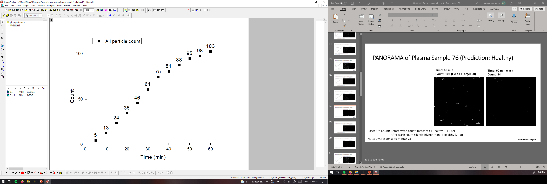
PANORAMA of Plasma Sample 76 (Prediction: Healthy)
Time: 60 min
Count: 103 (Ex: 43 ; Large: 60)
Time: 60 min wash
Count: 34
Based On Count: Before wash count matches CI Healthy (64-172)
After wash count slightly higher than CI Healthy (7-28)
Note: 0 % response to miRNA-21
Scale bar: 10 µm

Slide 3


PANORAMA of Plasma Sample 77 (Prediction: Healthy)
Time: 60 min
Count: 217 (Ex: 160 ; Large: 57)
Time: 60 min wash
Count: 25
Based On Count: Before wash count slightly higher CI Healthy (64-172)
After wash count matches CI Healthy (7-28)
Note: 0 % response to miRNA-21
Scale bar: 10 µm

Slide 4

PANORAMA of Plasma Sample 78 (Prediction: Healthy)
Time: 60 min
Count: 144 (Ex: 94; Large: 50)
Time: 60 min wash
Count: 22
Based On Count: Before wash count matches higher CI Healthy (64-172)
After wash count matches CI Healthy (7-28)
Note: 0 % response to miRNA-21
Scale bar: 10 µm

Slide 5
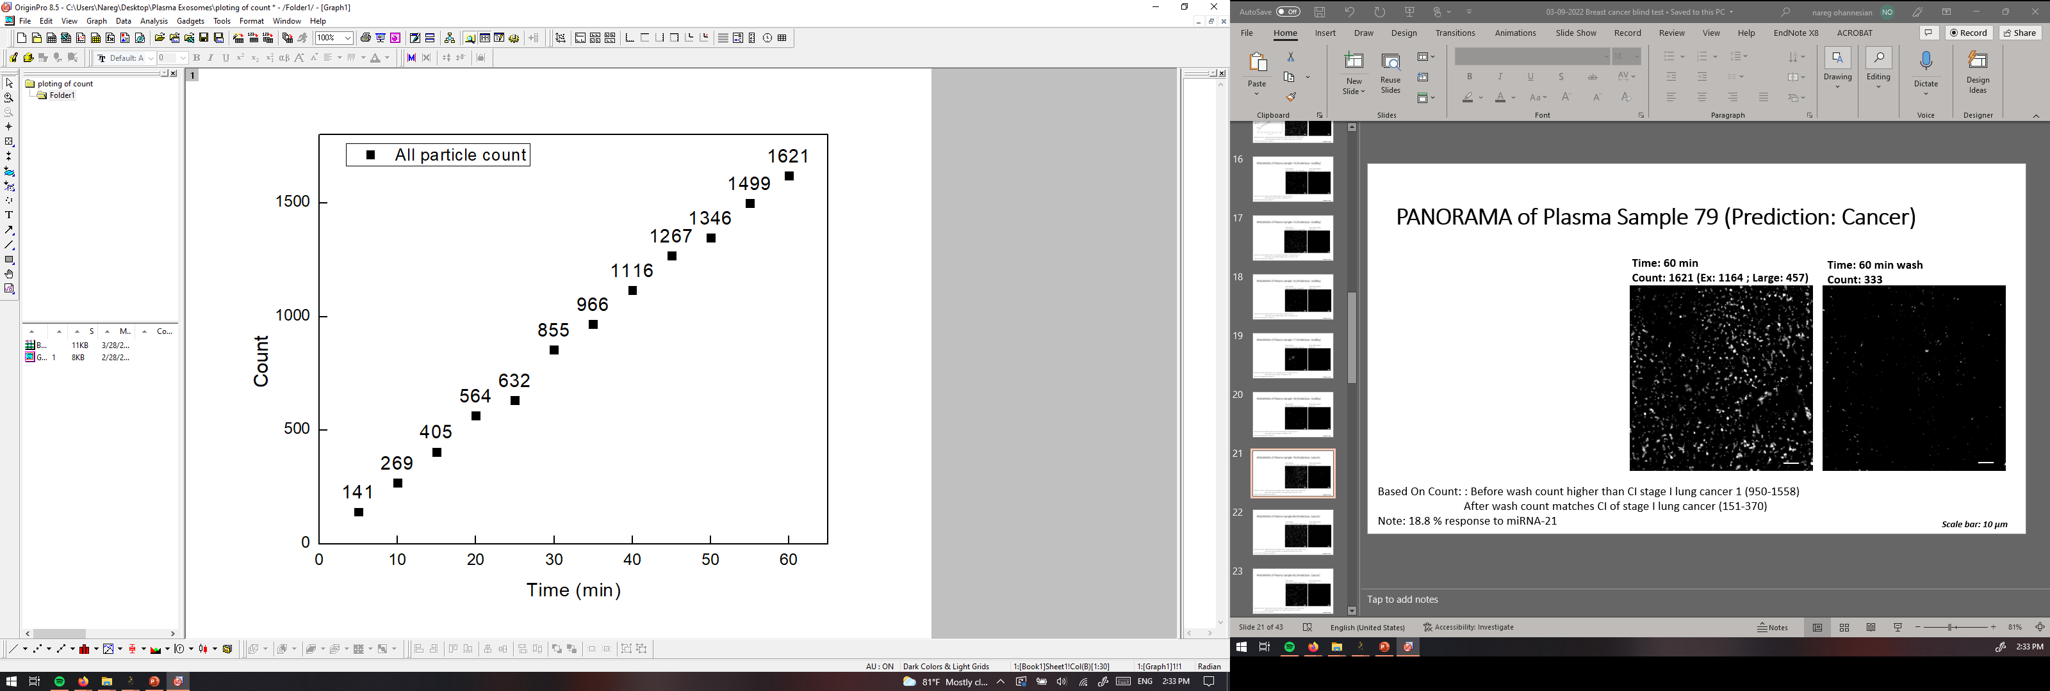
PANORAMA of Plasma Sample 79 (Prediction: Cancer)
Time: 60 min
Count: 1621 (Ex: 1164 ; Large: 457)
Time: 60 min wash
Count: 333
Based On Count: : Before wash count higher than CI stage I lung cancer 1 (950-1558)
After wash count matches CI of stage I lung cancer (151-370)
Note: 18.8 % response to miRNA-21
Scale bar: 10 µm

Slide 6


PANORAMA of Plasma Sample 80 (Prediction: Cancer)
Time: 60 min
Count: 1778 (Ex: 983 ; Large: 795)
Time: 60 min wash
Count: 340
Based On Count: : Before wash count higher than CI stage I lung cancer 1 (950-1558)
After wash count matches CI of stage I lung cancer (151-370)
Note: 16.6 % response to miRNA-21
Scale bar: 10 µm

Slide 7
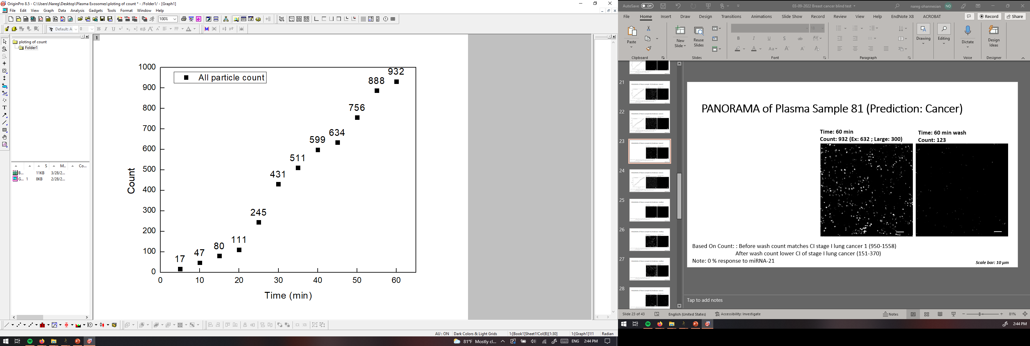
PANORAMA of Plasma Sample 81 (Prediction: Cancer)
Time: 60 min
Count: 932 (Ex: 632 ; Large: 300)
Time: 60 min wash
Count: 123
Based On Count: : Before wash count matches CI stage I lung cancer 1 (950-1558)
After wash count lower CI of stage I lung cancer (151-370)
Note: 0 % response to miRNA-21
Scale bar: 10 µm

Slide 8
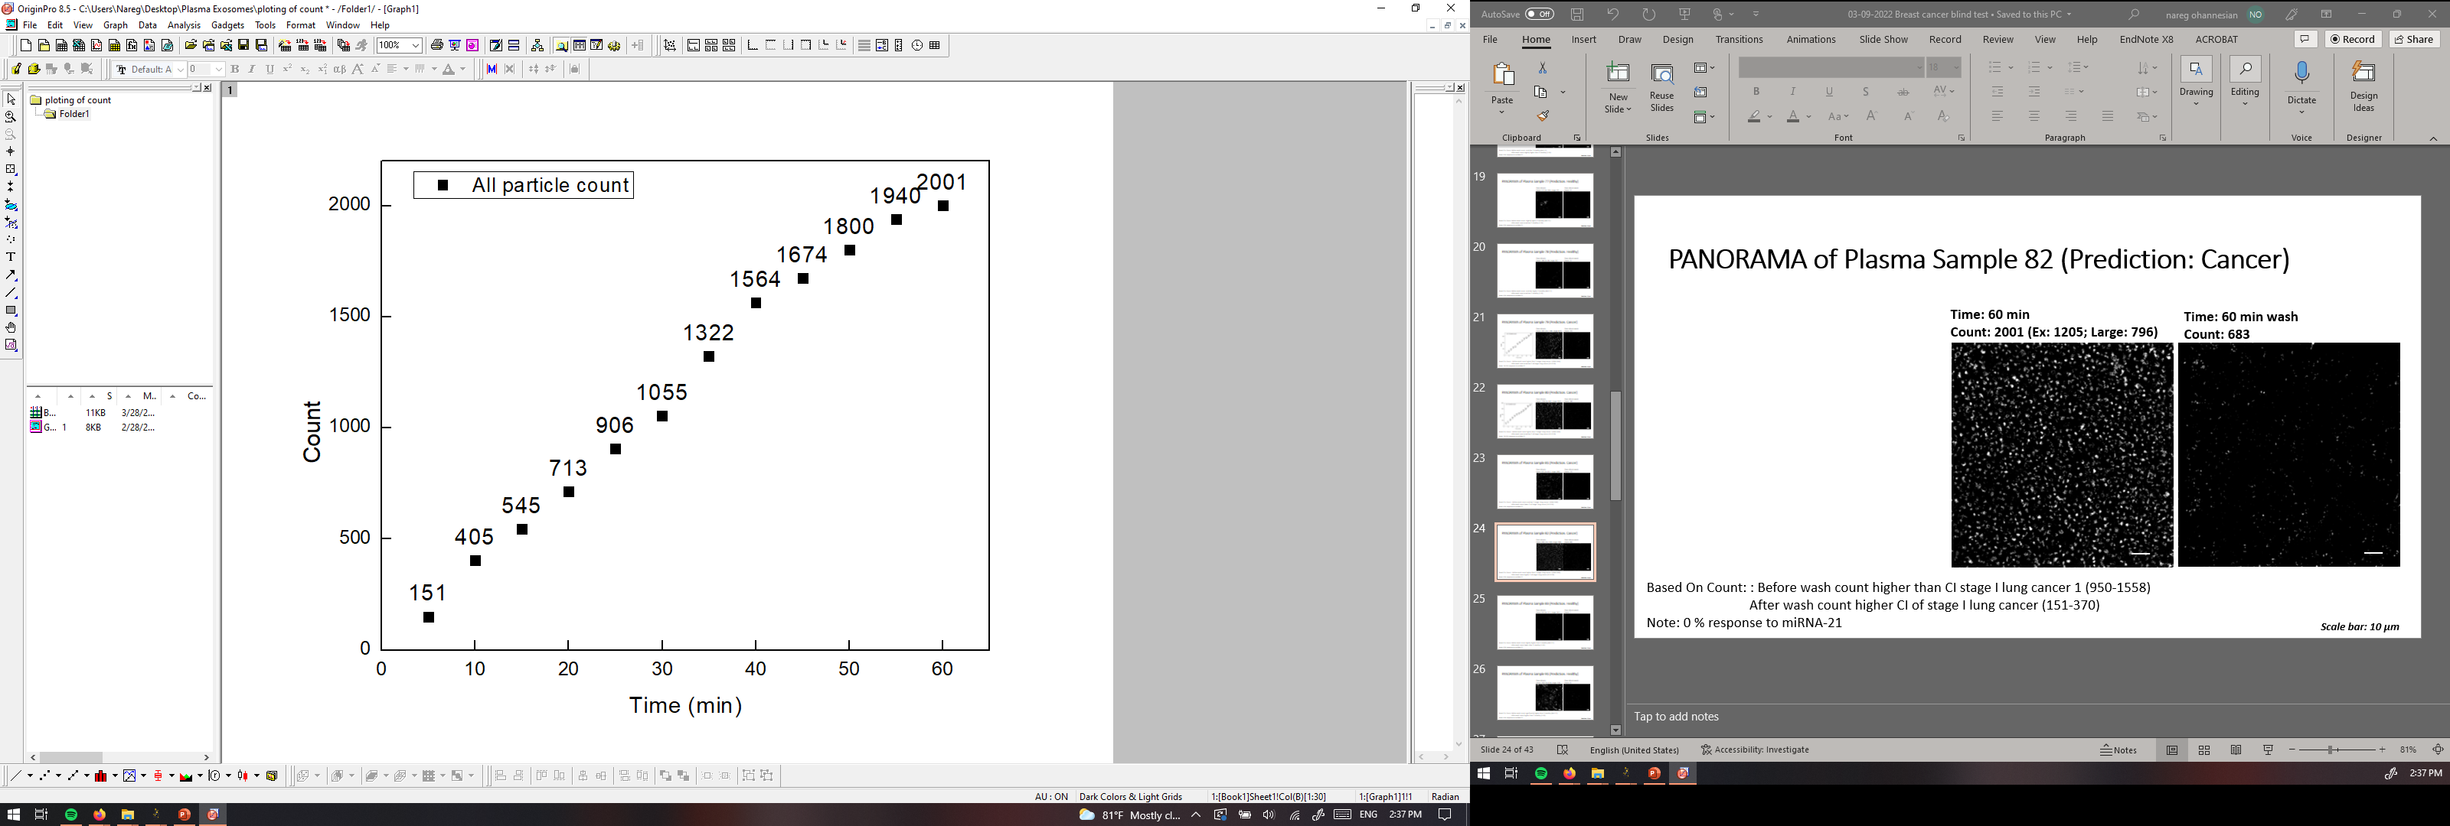
PANORAMA of Plasma Sample 82 (Prediction: Cancer)
Time: 60 min
Count: 2001 (Ex: 1205; Large: 796)
Time: 60 min wash
Count: 683
Based On Count: : Before wash count higher than CI stage I lung cancer 1 (950-1558)
After wash count higher CI of stage I lung cancer (151-370)
Note: 0 % response to miRNA-21
Scale bar: 10 µm

Slide 9


PANORAMA of Plasma Sample 83 (Prediction: Healthy)
Time: 60 min
Count: 222 (Ex: 121 ; Large: 101)
Time: 60 min wash
Count: 3
Based On Count: Before wash count slightly higher than CI Healthy (64-172)
After wash count lower than CI Healthy (7-28)
Note: 0 % response to miRNA-21
Scale bar: 10 µm

Slide 10
PANORAMA of Plasma Sample 84 (Prediction: Cancer)
Time: 60 min
Count: 617 (Ex: 504; Large: 113)
Time: 60 min wash
Count: 123
Based On Count: Before wash count lower than CI of stage 1 (950-1558)
After wash lower than CI stage 1 (151-370) and
higher than Healthy (5-70)
Note: 0% response to miRNA-21
Look cancerous
Scale Bar: 10 µm

Slide 11
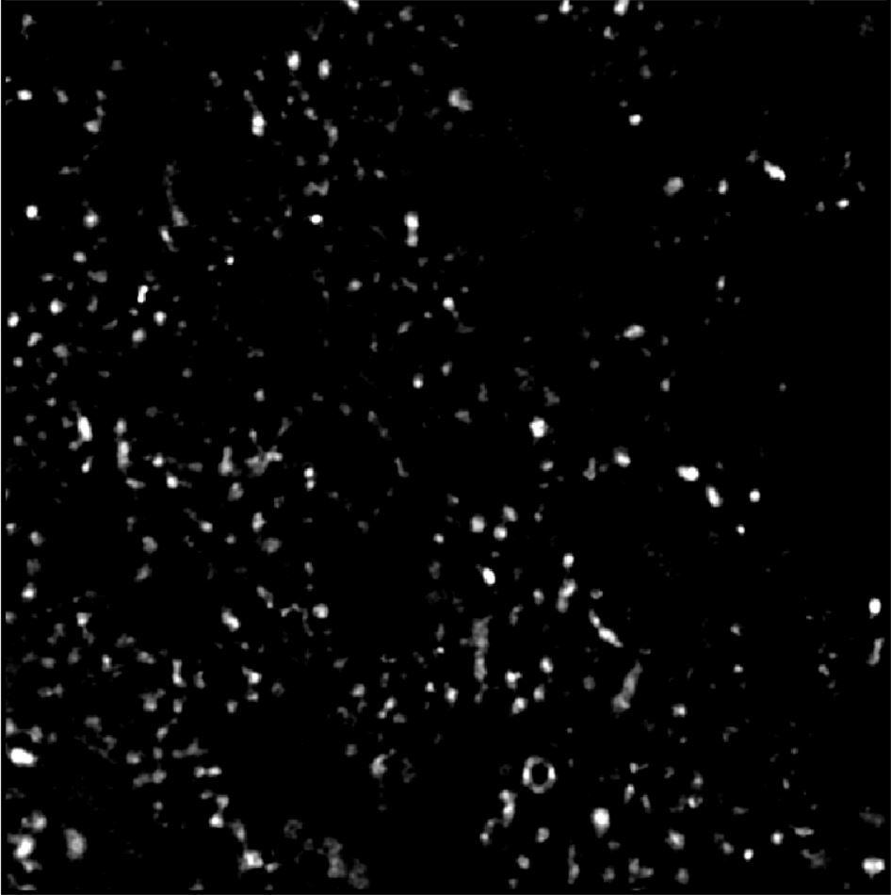

PANORAMA of Plasma Sample 85 (Prediction: Healthy)
Time: 60 min
Count: 445 (Ex: 345; Large: 100)
Time: 60 min wash
Count: 34
Based On Count: Before wash count higher than CI Healthy (64-172)
After wash count higher than 99% CI Healthy (5-28) ) but lower than 70
Note: 0 % response to miRNA-21
Look healthy
Scale Bar: 10 µm

Slide 12
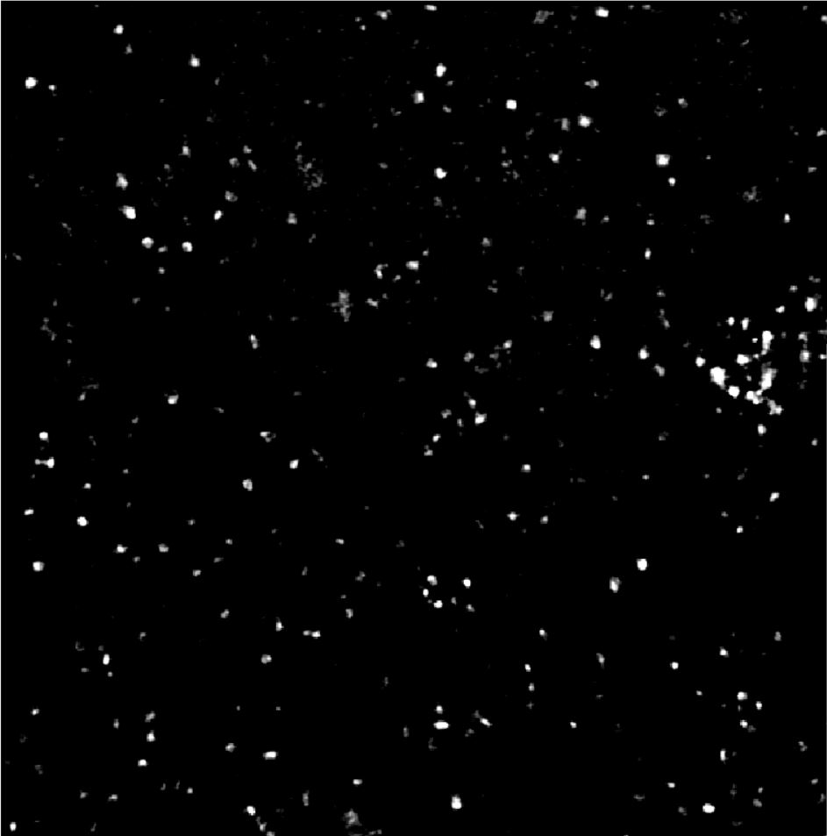
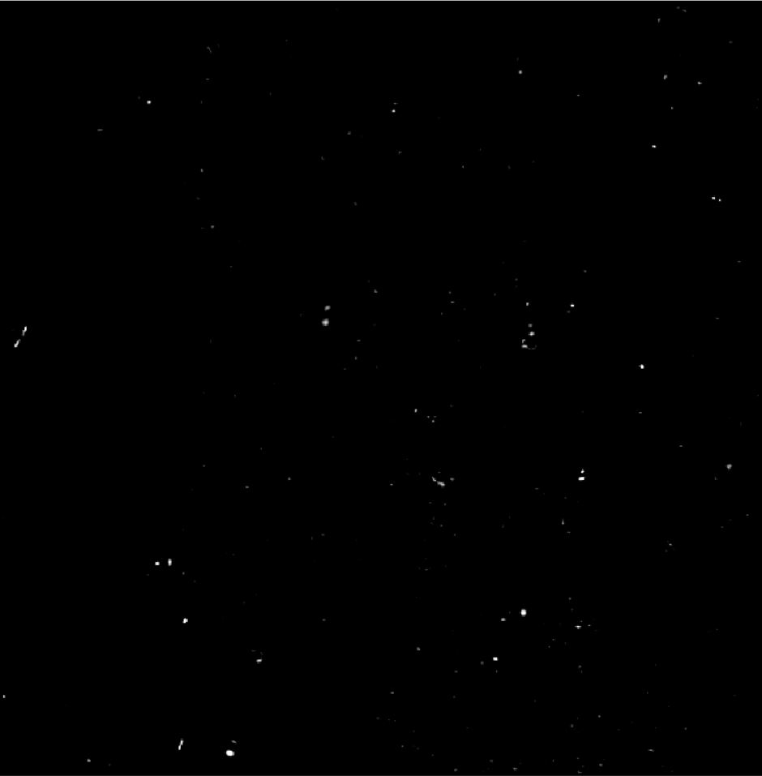
PANORAMA of Plasma Sample 86 (Prediction: Cancer)
Time: 60 min
Count: 352 (Ex: 227; Large: 125)
Time: 60 min wash
Count: 105
Based On Count: Before wash count lower than CI of stage 1 (950-1558)
After wash lower than CI stage 1 (151-370) and
higher than Healthy (5-70)
Note: 6 % response to miRNA-21
Look cancerous
Scale Bar: 10 µm

Slide 13
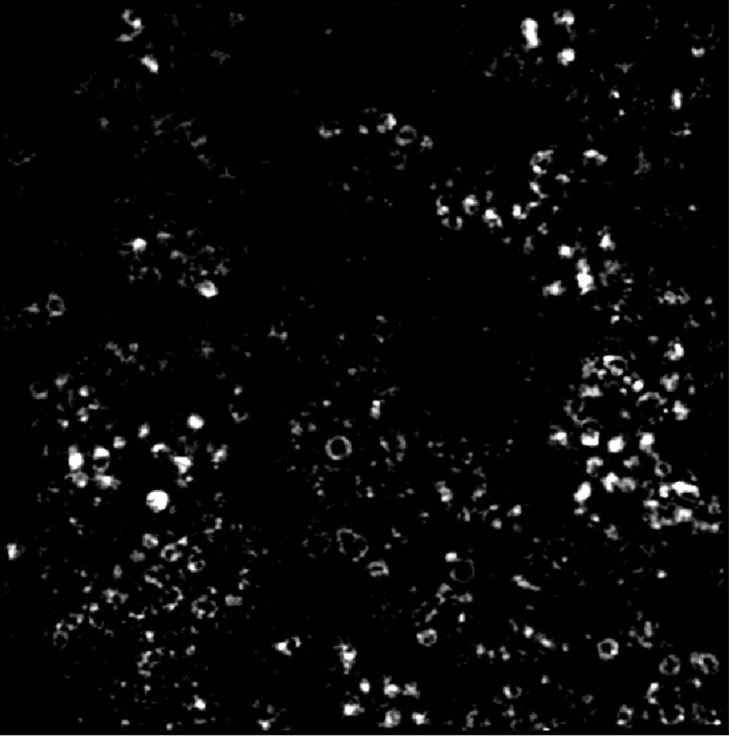

PANORAMA of Plasma Sample 87 (Prediction: Healthy)
Time: 60 min
Count: 297 (Ex: 213; Large: 84)
Time: 60 min wash
Count: 55
Based On Count: Before wash count higher than CI Healthy (64-172)
After wash count higher than 99% CI Healthy (5-28) ) but lower than 70
Note: 0 % response to miRNA-21
Look healthy
Scale Bar: 10 µm

Slide 14
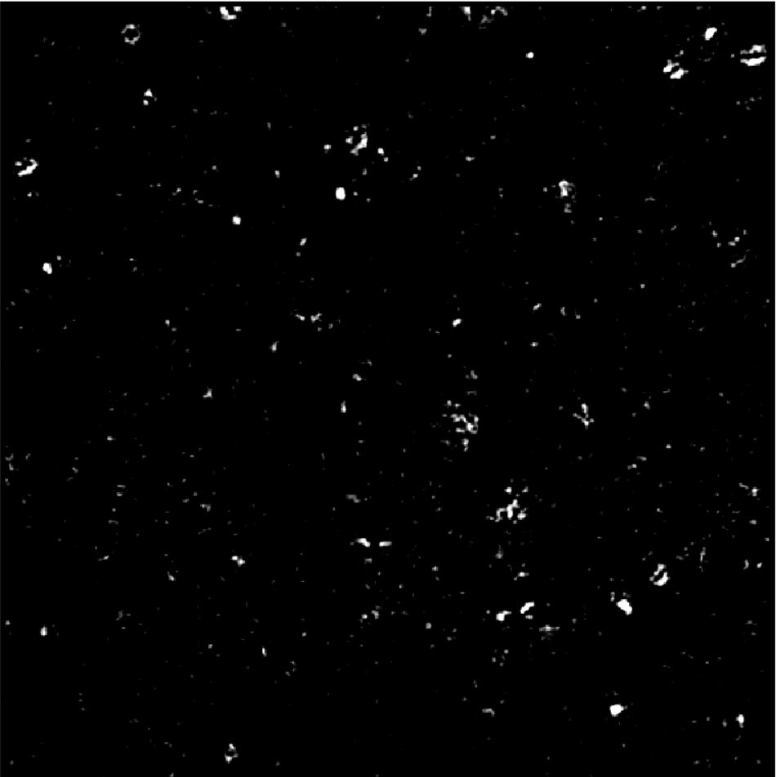

PANORAMA of Plasma Sample 88 (Prediction: Healthy)
Time: 60 min
Count: 371 (Ex: 327; Large: 44)
Time: 60 min wash
Count: 28
Based On Count: Before wash count higher than CI Healthy (64-172)
After wash count matches 99% CI Healthy (5-28)
Note: 0 % response to miRNA-21
Look healthy
Scale Bar: 10 µm

Slide 15
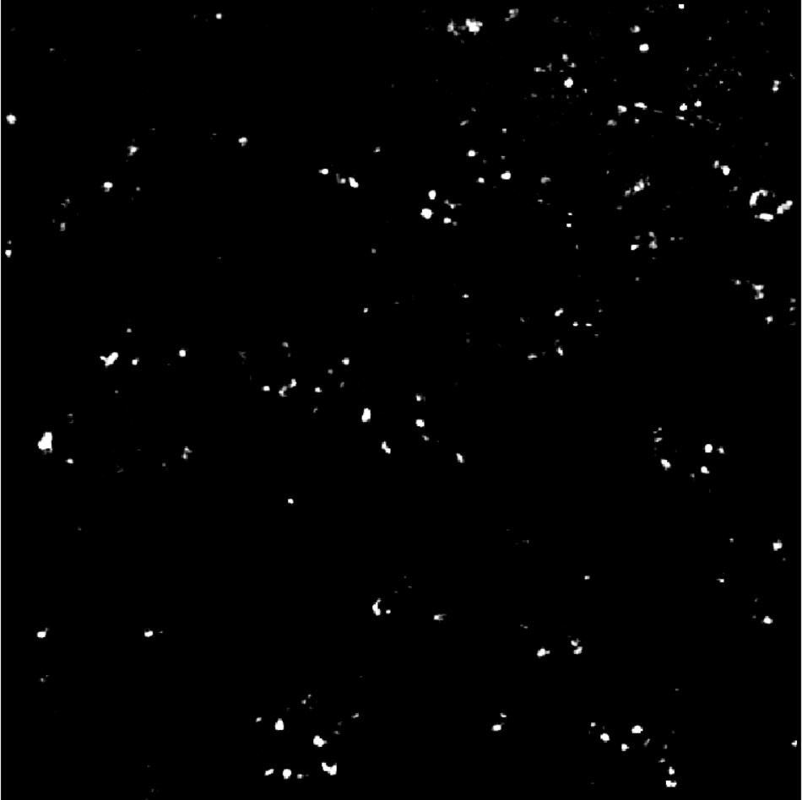

PANORAMA of Plasma Sample 89 (Prediction: Healthy)
Time: 60 min
Count: 234 (Ex: 164; Large: 70)
Time: 60 min wash
Count: 43
Based On Count: Before wash count higher than CI Healthy (64-172)
After wash count higher than 99% CI Healthy (5-28) ) but lower than 70
Note: 0 % response to miRNA-21
Look healthy
Scale Bar: 10 µm

Slide 16
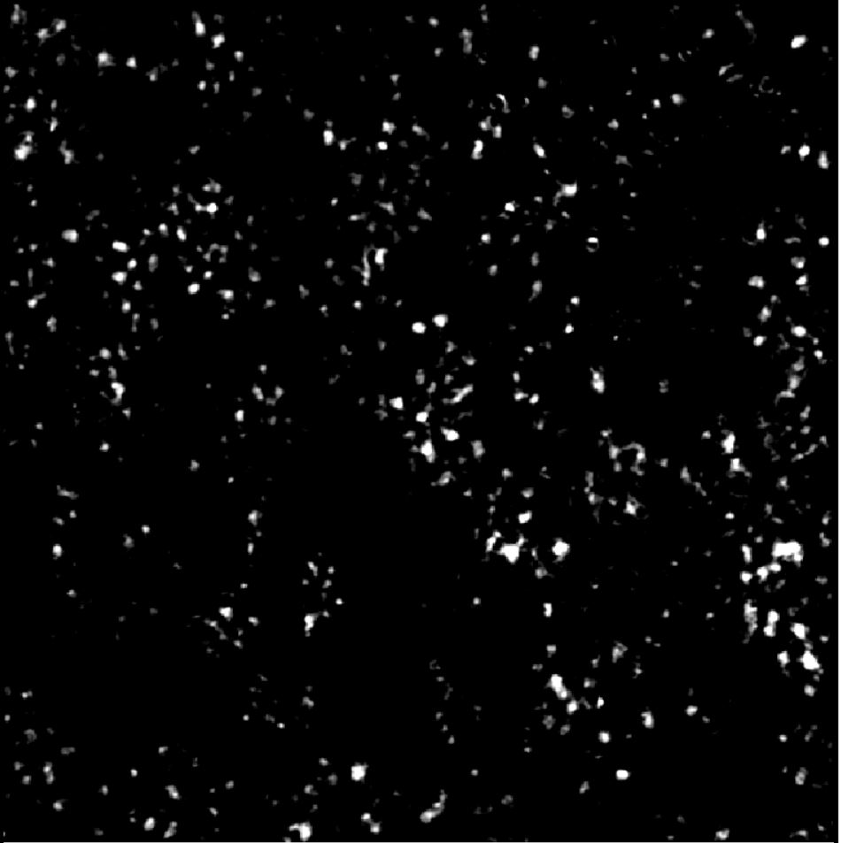

PANORAMA of Plasma Sample 90 (Prediction: Cancer)
Time: 60 min
Count: 481 (Ex: 324; Large: 157)
Time: 60 min wash
Count: 108
Based On Count: Before wash count lower than CI of stage 1 (950-1558)
After wash lower than CI stage 1 (151-370) and
higher than Healthy (5-70)
Note: 7.1 % response to miRNA-21
Look cancerous
Scale Bar: 10 µm

Slide 17

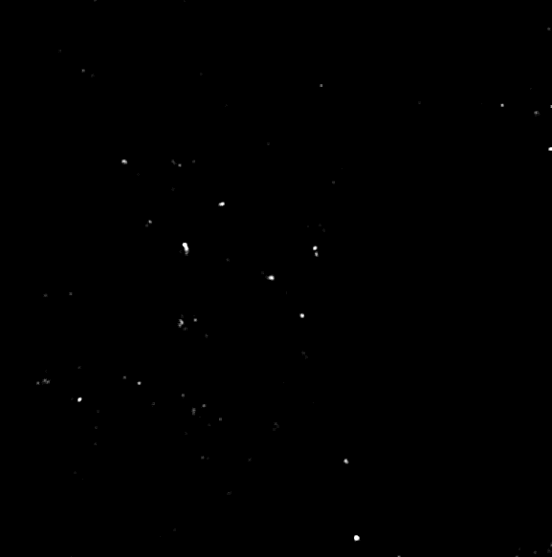
PANORAMA of Plasma Sample 91 (Prediction (based on MIR-21): Healthy)
Time: 60 min
Count: 1033 (Ex: 814; Large: 219)
Time: 60 min wash
Count: 81
Based On Count: Before wash count significantly higher than CI Healthy (64-172)
After wash count higher than CI Healthy (7-28)
Note: 0 % response to miRNA-21
Scale bar: 10 µm

Slide 18
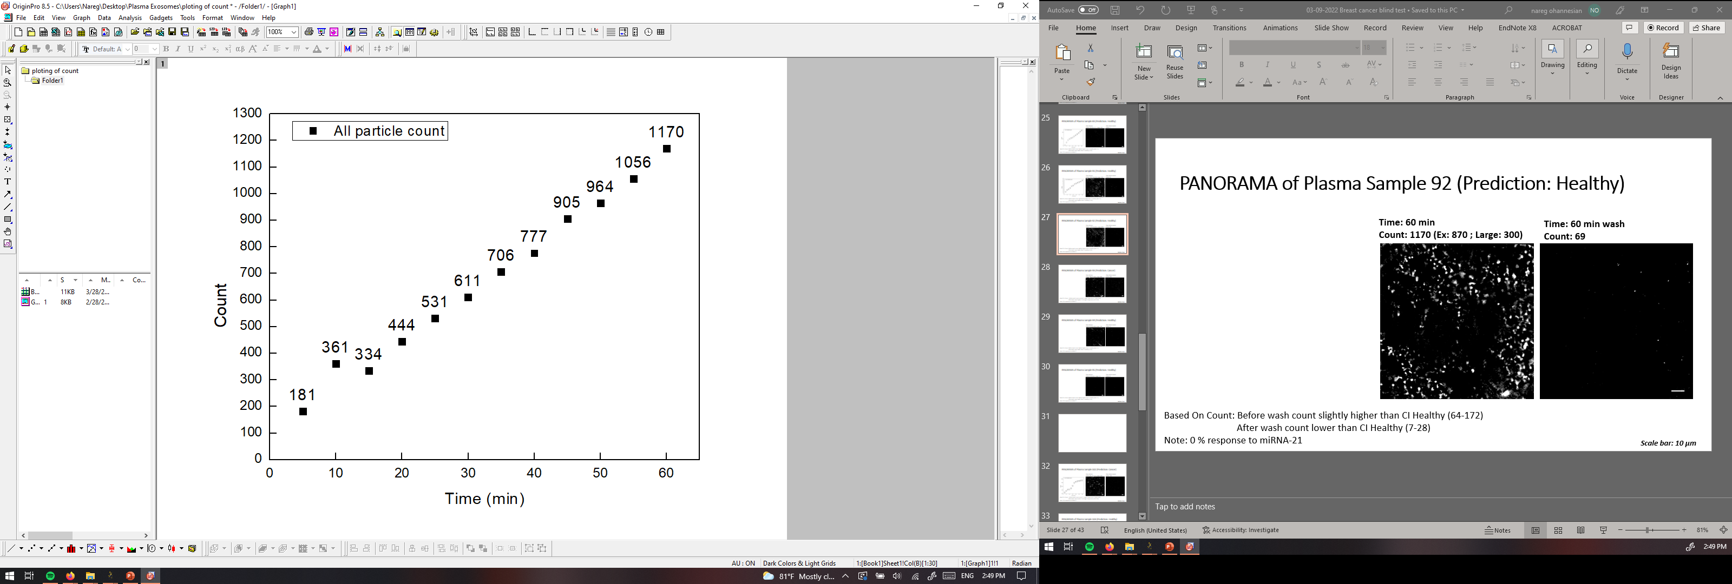
PANORAMA of Plasma Sample 92 (Prediction: Healthy)
Time: 60 min
Count: 1170 (Ex: 870 ; Large: 300)
Time: 60 min wash
Count: 69
Based On Count: Before wash count slightly higher than CI Healthy (64-172)
After wash count lower than CI Healthy (7-28)
Note: 0 % response to miRNA-21
Scale bar: 10 µm

Slide 19
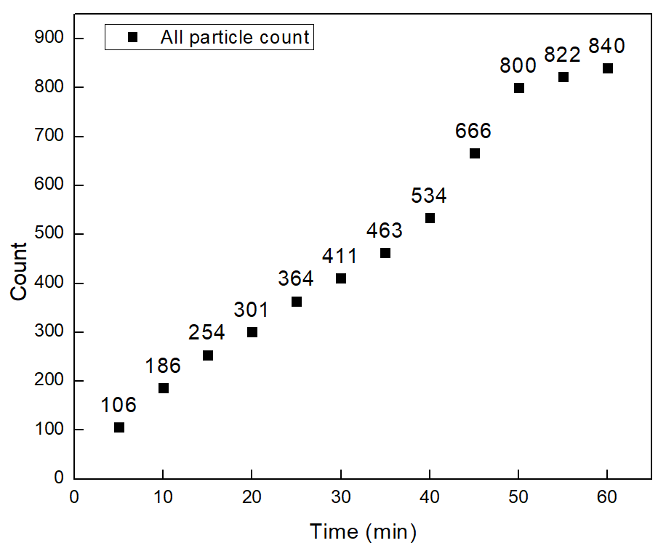


PANORAMA of Plasma Sample 93 (Prediction: Cancer)
Time: 60 min
Count: 840 (Ex: 692; Large:148)
Time: 60 min wash
Count: 456
Based On Count: : Before wash count matcheCI stage I lung cancer 1 (950-1558)
After wash count higher CI of stage I lung cancer (151-370)
Note: 0 % response to miRNA-21
Scale bar: 10 µm

Slide 20


PANORAMA of Plasma Sample 94 (Prediction: Healthy)
Time: 60 min
Count: 617(Ex: 459; Large: 158)
Time: 60 min wash
Count: 51
Based On Count: Before wash count significantly higher than CI Healthy (64-172)
After wash count lower than CI Healthy (7-28)
Note: 0 % response to miRNA-21
Scale bar: 10 µm

Slide 21

PANORAMA of Plasma Sample 95 (Prediction: Healthy)
Time: 60 min
Count: 91(Ex: 80 ; Large: 11)
Time: 60 min wash
Count: 8
Based On Count: Before wash count slightly higher than CI Healthy (64-172)
After wash count lower than CI Healthy (7-28)
Note: 0 % response to miRNA-21
Scale bar: 10 µm

Slide 22


PANORAMA of Plasma Sample 96 (Prediction: Healthy)
Time: 60 min
Count: 210 (Ex: 196; Large: 14)
Time: 60 min wash
Count: 35
Based On Count: Before wash count higher than CI Healthy (64-172)
After wash count higher than 99% CI Healthy (5-28) ) but lower than 70
Note: 0 % response to miRNA-21
Look healthy
Scale Bar: 10 µm

Slide 23
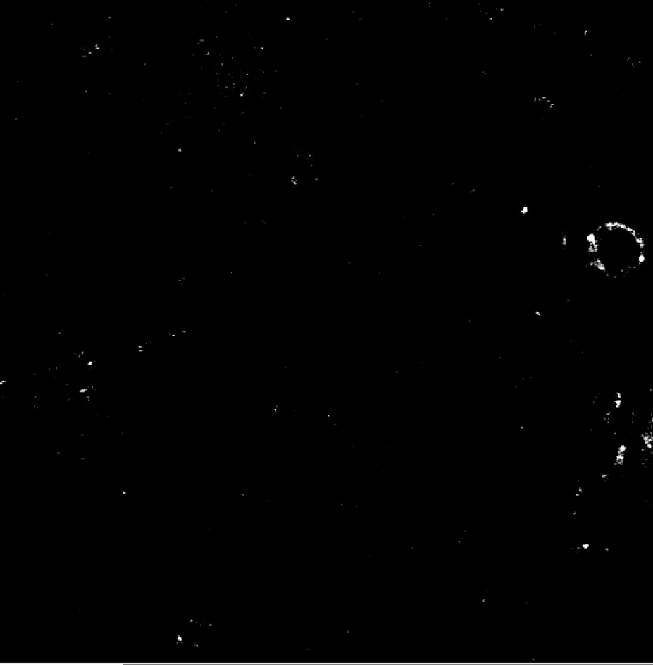

PANORAMA of Plasma Sample 97 (Prediction: Healthy)
Time: 60 min
Count: 231 (Ex: 204; Large: 27)
Time: 60 min wash
Count: 17
Based On Count: Before wash count higher than CI Healthy (64-172)
After wash count matches 99% CI Healthy (5-28)
Note: 0 % response to miRNA-21
Look healthy
Scale Bar: 10 µm

Slide 24
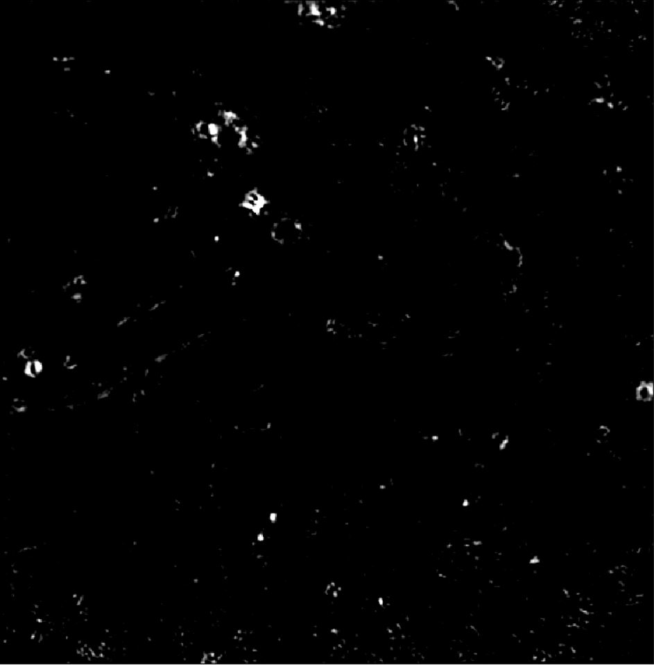
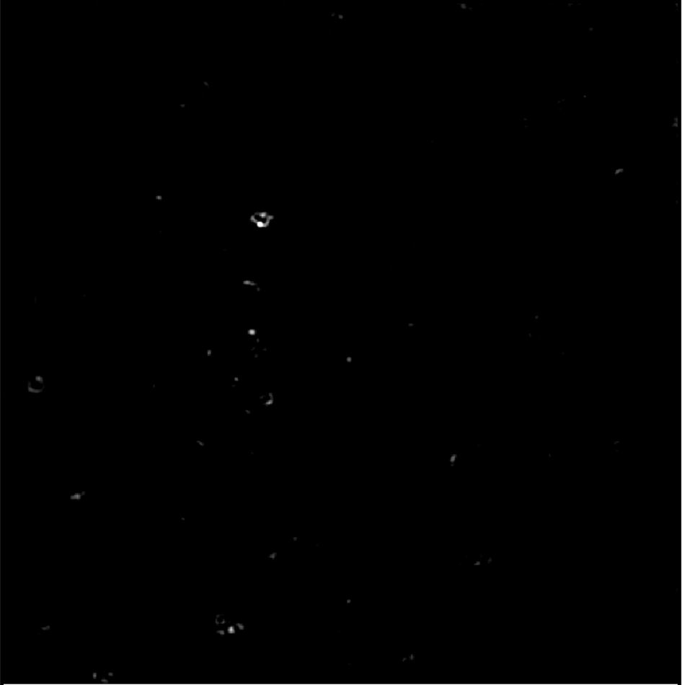
PANORAMA of Plasma Sample 98 (Prediction: Healthy)
Time: 60 min
Count: 196 (Ex: 157; Large: 39)
Time: 60 min wash
Count: 30
Based On Count: Before wash count higher than CI Healthy (64-172)
After wash count higher than 99% CI Healthy (5-28) ) but lower than 70
Note: 0 % response to miRNA-21
Look healthy
Scale Bar: 10 µm

Slide 25
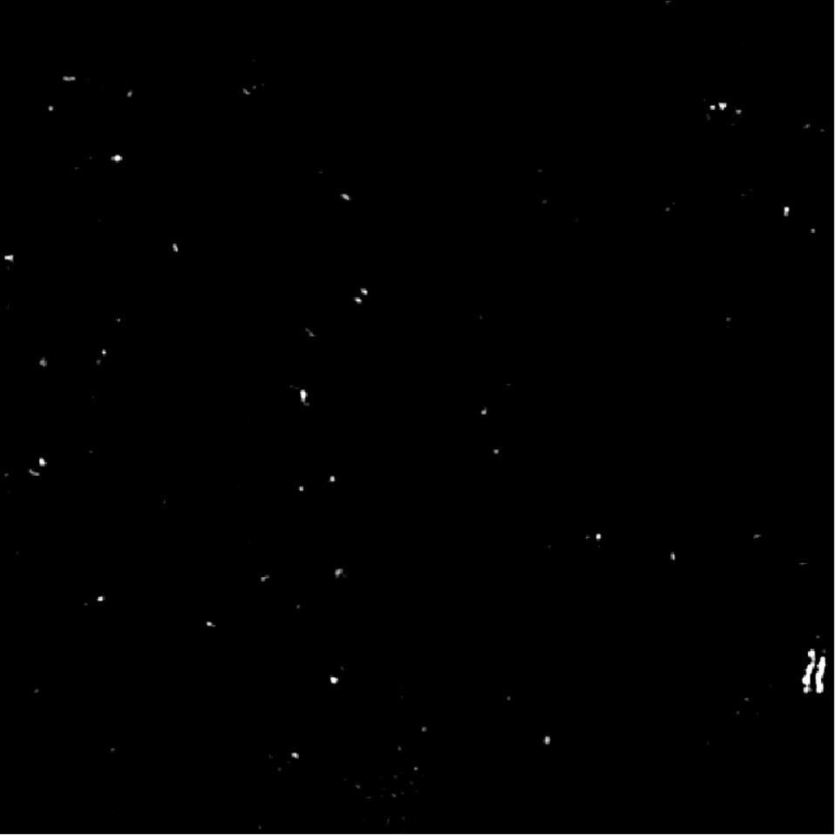

PANORAMA of Plasma Sample 99 (Prediction: Healthy)
Time: 60 min
Count: 84 (Ex: 60; Large: 24)
Time: 60 min wash
Count: 40
Based On Count: Before wash count higher than CI Healthy (64-172)
After wash count higher than 99% CI Healthy (5-28) ) but lower than 70
Note: 0 % response to miRNA-21
Look healthy
Scale Bar: 10 µm

Slide 26
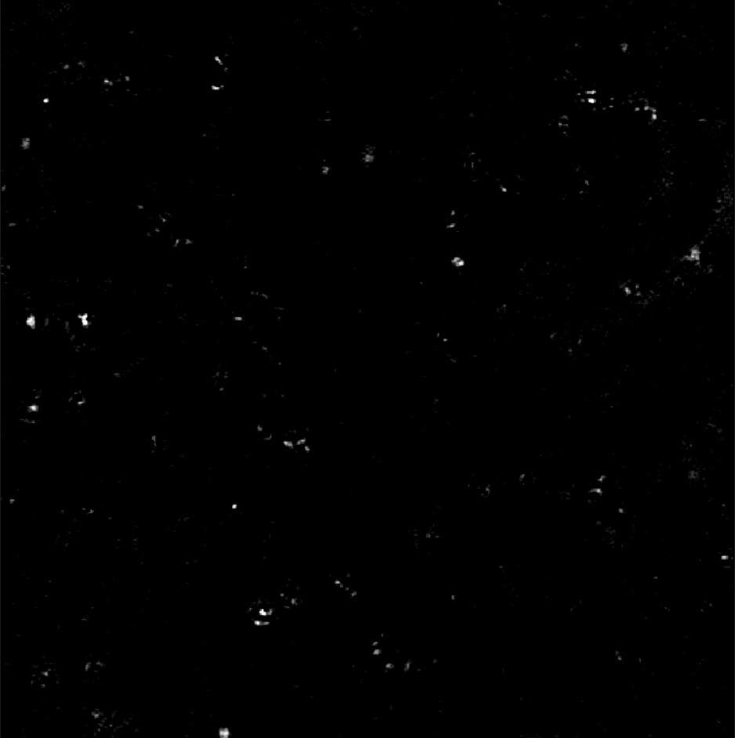

PANORAMA of Plasma Sample 100 (Prediction: Healthy)
Time: 60 min
Count: 227 (Ex: 178; Large: 49)
Time: 60 min wash
Count: 32
Based On Count: Before wash count higher than CI Healthy (64-172)
After wash count higher than 99% CI Healthy (5-28) ) but lower than 70
Note: 0 % response to miRNA-21
Look healthy

